Slide 1

Unit Testing - GraphQL / Apollo Client
By Vilva Athiban
@vilvaathibanpb

Slide 2
About Me
Javascript Developer, Mostly on the Browser
Blogging in Medium - Vilva Athiban P B
I do cartoons on Tech and will soon release a complete tutorial on Apollo GraphQL in Youtube.
Twitter @vilvaathibanpb , Youtube - Vilva Athiban
Open Source contributor.
I code on JS, React, GraphQL these days.
Also, I love to teach

Slide 3
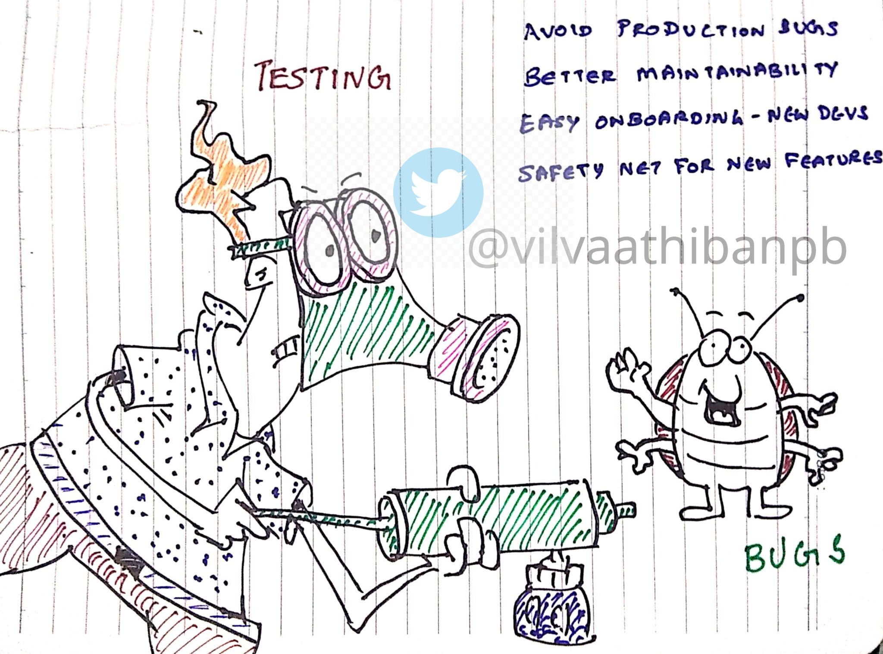

Slide 4
Demo Time - Keep it quick

Slide 5
Further ?
Testing Mutations
Testing Apollo-Server - createTestClient
Handling real-time issues

Slide 6
QA Time
Thank you !
Feedback and Suggestions are welcome
Available for offline discussions
Follow me on twitter - @vilvaathibanpb

